Slide 1


Slide 2
Team Name And Member details: Member1:Neha Mangal Year:First Year. Branch:Computer Science. Member2:Jyoti Soni Year:First Year. Branch:Electrical And Communication. College:Jaipur Engineering College And Research Center. Both are in Same college.
tHEME:
Education
Education is one of the cornerstones of human civilization and is of extreme importance to us. Over the years, E-books, virtual classrooms and online education portals have revolutionized education. With the birth of internet in the late 20th century it is possible to learn anything under the sun. Today It is even more important to incorporate new technology and develop tools to help make learning more effective and inclusive.

Slide 3
PROBLEM STATEMENT: The COVID-19 pandemic has affected educational systems worldwide, leading to the near-total closures of schools,universities and colleges. Students have lost the class atmosphere. The student's learning capability has reduced and it has effected student's health. The student's have lost discipline and are becoming idle. The student don't get to solve their queries without their teacher on their own at home. So, a different virtual education system is necessary for learning in this time of pandemic.

Slide 4
SOLUTION: Through online virtual education methods are already implemented, there is always a need of having a better technology and developed tools.We have come up with an app having ebooks, classes and doubt sessions, where students can learn feeling like they are sitting in the classroom. There can a regular contact between students and teachers. And a scope for students to share their queries and solutions with others. The videos and pictures help them to understand more effectively. This saves time for students and make them learn more effectively.

Slide 5
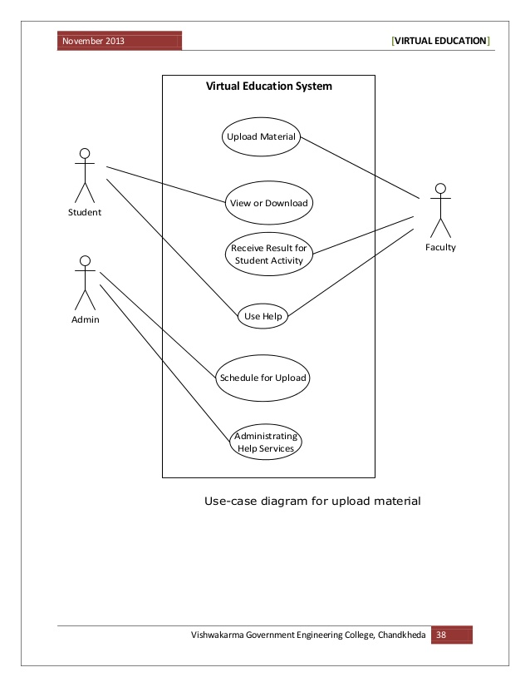
MATHODOLOGY:
ARCHITECTURE DIAGRAM

Slide 6
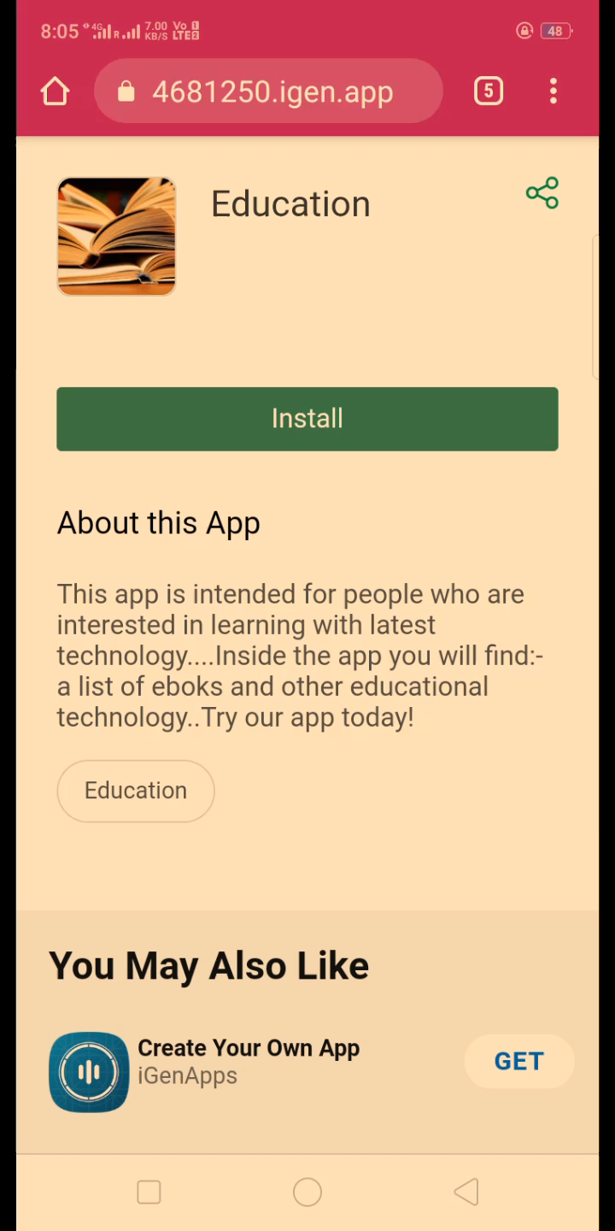
Clip bases to more improvement in online education system: :

Slide 7


